Slide 1
Loan Analysis
Bideepta Basu

Slide 2
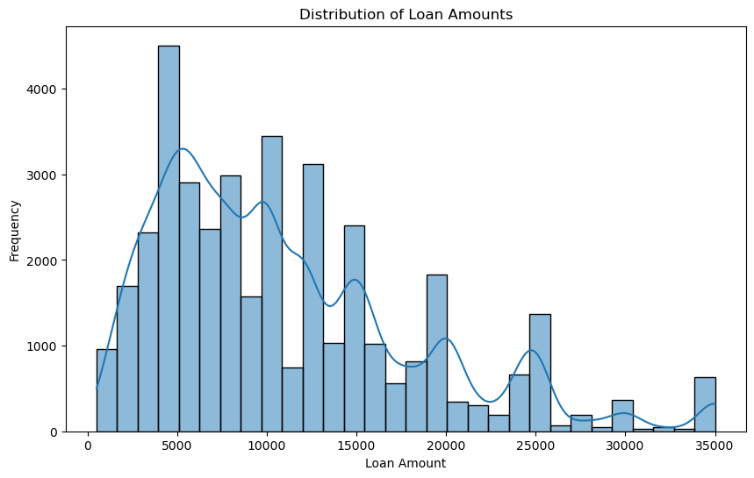
Loan Amount Taken Max
Observation:
1. Maximum loan amount taken in of Rs. 5000/-

Slide 3
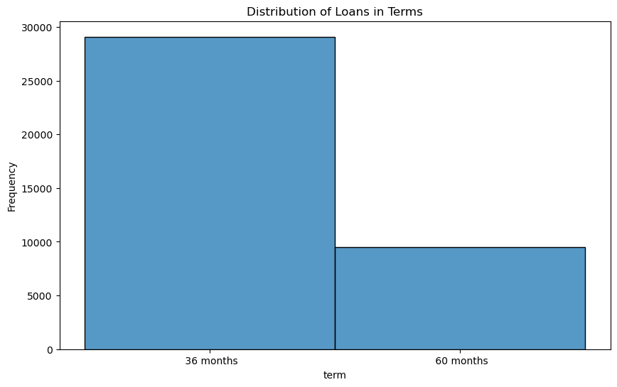
Loan Term
Observation:
1. Loan taken of tenure 36 months is more than double than that of 60 months

Slide 4
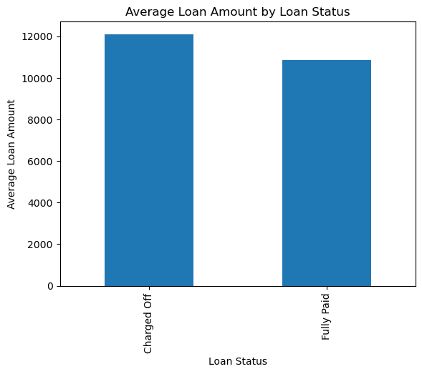
Loan Amount vs Loan Status
Observation:
1. Average ticket size of charged off loans are more than Fully paid loans

Slide 5
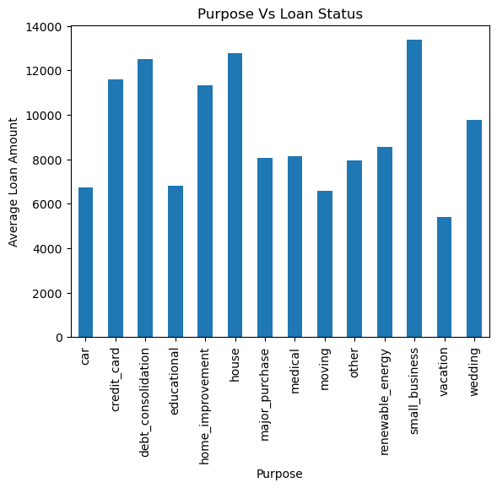
Purpose vs Loan Status
Observation:
1. Average ticket size of loans taken for small business is highest

Slide 6
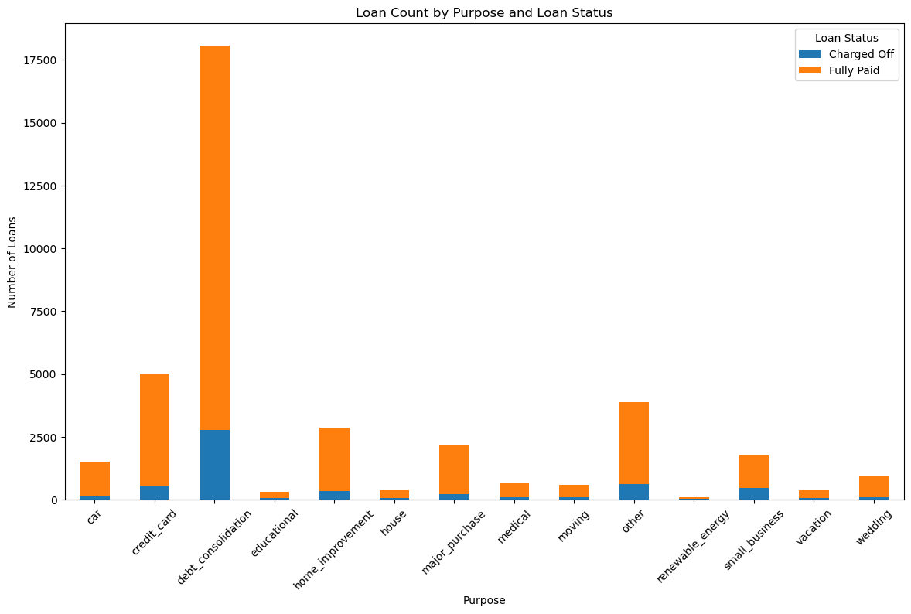
Purpose vs Loan Status wise count
Observation:
1. Loan taken for debt consolidation incurs the highest charged off amount.

Slide 7
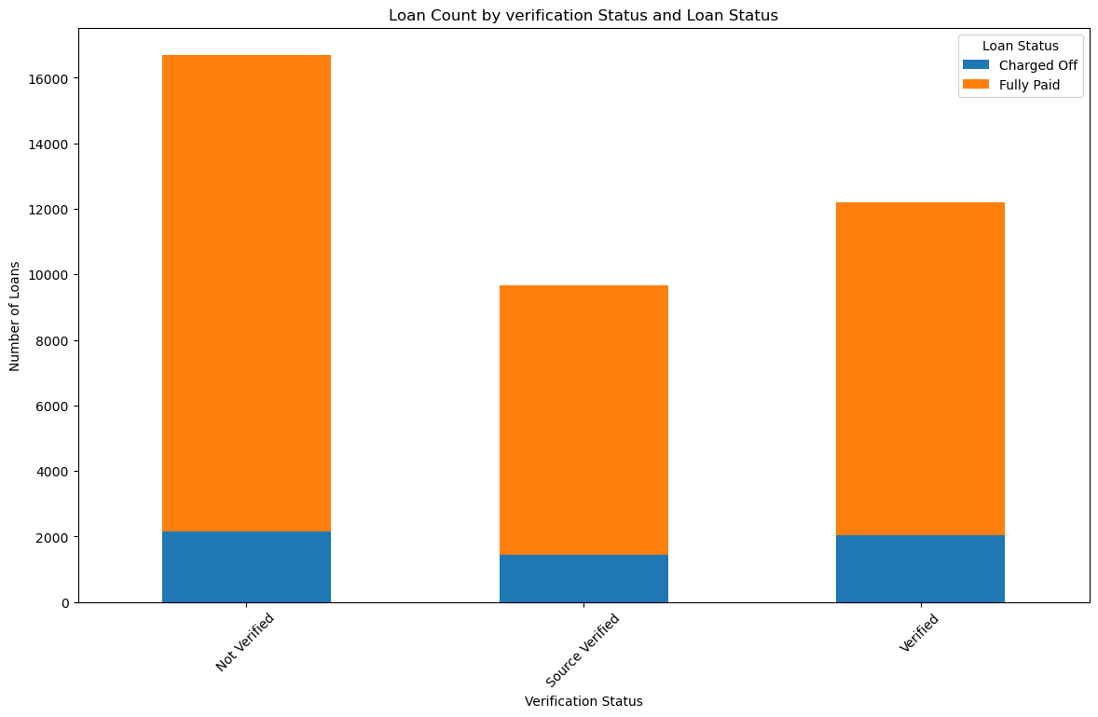
Income Verification status vs Loan Status wise count
Observation:
1. Share of not verified loan count is highest among all types in verification. Although it has not any significant impact on loan status

